Slide 1

HTML/CSS Basics
Woosung Jang, Sunpil Howang, Dahyun Choi

Slide 2
Languages of the Web
HTML
The structure of a webpage
CSS
The presentation of a webpage – how it should look
JavaScript
The functionality of a webpage

Slide 3
HTML

Slide 4
HTML
HTML is a Markup language
Tags and other markup instruct the browser HOW to render a page
Gives a natural structure to the content

Slide 5
HTML Tags
<h1>Hello, World</h1>
Opening Tag
Closing Tag

Slide 6
HTML Tags
<h1>Hello, World</h1>
Tag Name
Or Type

Slide 7
HTML Tags
<h1>Hello, World</h1>
Content

Slide 8
HTML Tags
<h1 class="big-title"></h1>
Attribute

Slide 9
HTML Tags
<h1 class="big-title"></h1>
Attribute Name
Attribute Value

Slide 10
HTML Tags
<h1 class="big-title text-bold text-italic"></h1>

Slide 11
HTML Tags
<h1 class="big-title" id="first-heading"></h1>

Slide 12
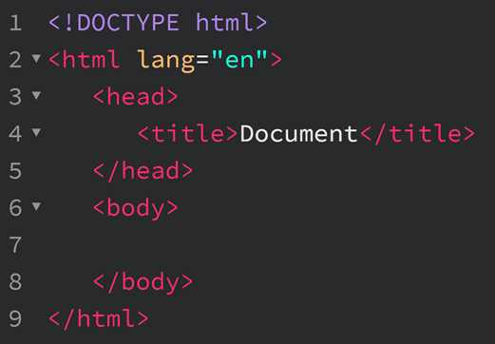
Basic HTML Document Structure
The version of HTML this page uses
Root element of our document
Metadata about this page
Title of the page
Content that users see

Slide 13
<head> vs <body>
<head>
Meta info about the page
Page title
External CSS and JS files
Meta tags (website author, description, keywords)
<body>
What actually gets displayed to users
Markup of the page (headings, paragraph, text, images, links)
JavaScript

Slide 14
Grouping Elements (Containers)
<div> and <span>
These are generic container, or grouping, elements
Have no semantic meaning
Used to group other elements into "blocks" of code
Usually add a class or id to them so we can target that part of the page with certain styles
Notes:
More information about Div and Span Elements: https://docs.microsoft.com/en-us/previous-versions/visualstudio/visual-basic-6/aa241735(v=vs.60)
More information about other elements: https://www.w3.org/TR/html5/grouping-content.html#elementdef-p

Slide 15
Block and Inline
Block-Level Elements:
Start on a new line
Take up the full width of their parent element automatically
<div>, <h1>, <p>
Inline Elements:
Stay…inline
Don't interrupt the flow of text
Only as large as the content inside of it
<span>, <a>, <img>
Notes:
More information about Block and Inline: https://www.w3schools.com/html/html_blocks.asp

Slide 16
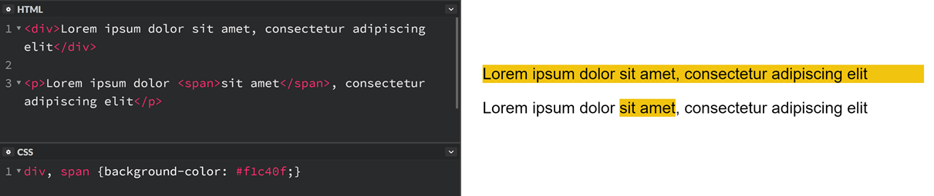
Block and Inline

Slide 17
Other Display Types
display:inline-block; An element that displays inline in terms of flow, but can have an explicit width/height and can have margin top and bottom like block-level elements
display:none; The element will not be rendered at all
display:table; Act like a <table> element
display:flex; Display as a block-level flex container This is the new way we'll lay pages out in this class in weeks to come!

Slide 18
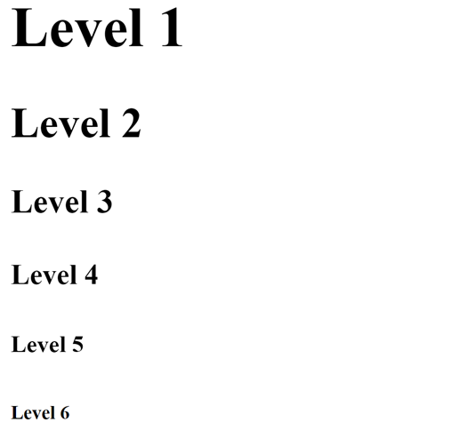
Headings
<h1> Level 1 </h1>
<h2> Level 2 </h2>
<h3> Level 3 </h3>
<h4> Level 4 </h4>
<h5> Level 5 </h5>
<h6> Level 6 </h6>
Notes:
More information about Heading Tags: https://www.w3schools.com/html/html_headings.asp

Slide 19
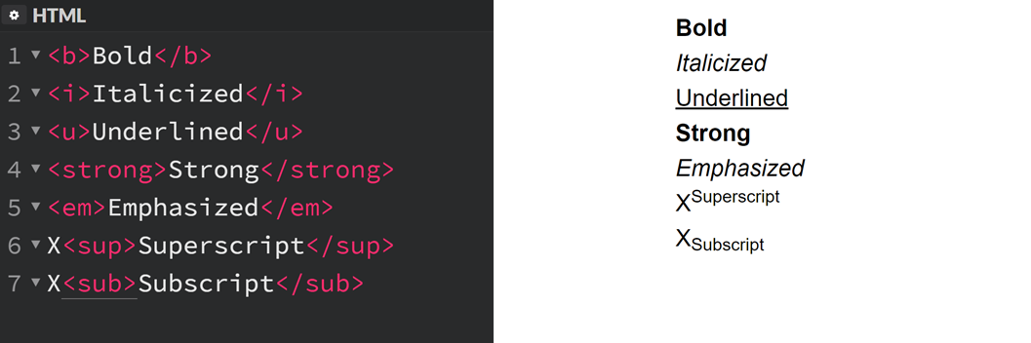
Other Typography-Related Tags
Notes:
More information about other Typography-Related Tags: https://www.w3schools.com/html/html_formatting.asp

Slide 20

Images
Banner of Chadwick Homepage

Slide 21
Images
Images use the <img> tag
No closing tag
Required: src and alt attributes
Put picture title to alt section
<img src="/wp-content/themes/chadwick/images/slide1.jpg"alt="" />
Notes:
More information about Images: https://developer.mozilla.org/en-US/docs/Learn/HTML/Multimedia_and_embedding/Images_in_HTML

Slide 22

Links
Links use the <a> tag
<a href="https://www.chadwickresidence.org">
Chadwick Residence Website
</a>

Slide 23
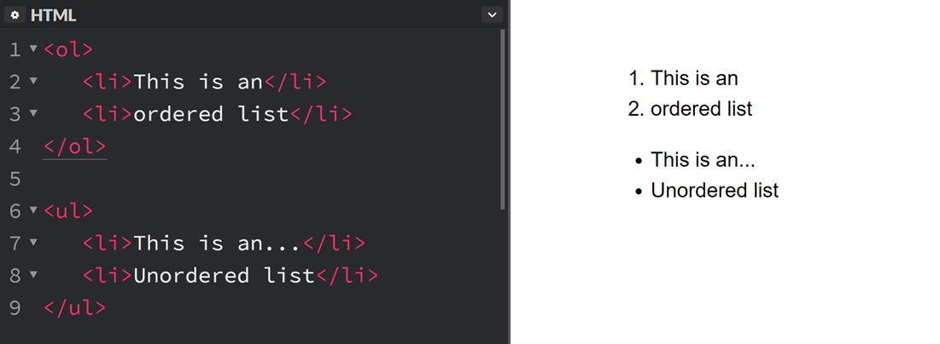
Lists

Slide 24
Tables
Use for displaying tabular data
Lots of markup involved
Need to have tags to define parts of the table, each row of the table, and then each cell
Should also include a caption and various scope attributes for better accessibility! (More on accessibility later on in the semester)
Notes:
More information about Table: https://css-tricks.com/complete-guide-table-element/

Slide 25
CSS

Slide 26
Stylesheets
Stylesheets are a collection of CSS rules
They can be added directly to an HTML document via the <style> tag
Usually a separate file that is referenced externally like styles.css
Stylesheets define how the page should visually look
Colors, fonts, sizing, manipulating layout and position, simple interactivity

Slide 27
Anatomy of a Style
body {
padding: 0;
margin: 0;
}
Rule
Notes:
More information about CSS Rule: https://www.w3schools.com/css/css_syntax.asp

Slide 28
Anatomy of a Style
body {
padding: 0;
margin: 0;
}
Selector

Slide 29
Anatomy of a Style
body {
padding: 0;
margin: 0;
}
Declarations

Slide 30
Anatomy of a Style
body {
padding: 0;
}
Property
Value

Slide 31
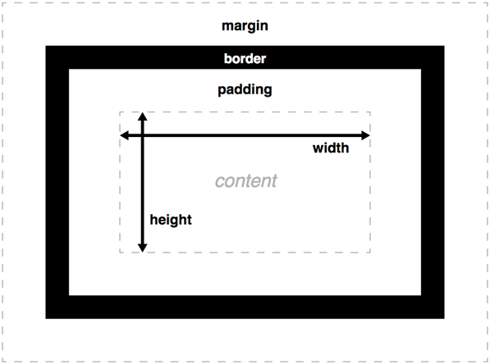
Box Model
Every element has:
A content area (width and height)
Padding
Border
Margin
The summation of these values dictate how much space the element will take up on the page
Notes:
More information about Box Model: https://developer.mozilla.org/en-US/docs/Learn/CSS/Introduction_to_CSS/Box_model

Slide 32
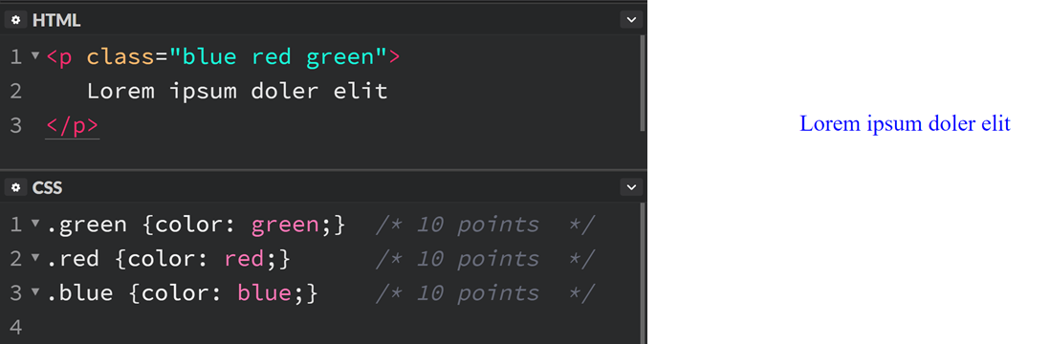
Specificity
If multiple rules resolve to the same point value for specificity, the last rule defined is used
Notes:
More information about CSS Specificity: https://developer.mozilla.org/en-US/docs/Web/CSS/Specificity

Slide 33
Specificity
The browser determines what CSS rule to use by using a point system based on the selector
*This is actually a simplified explanation but it works for our purposes. Browsers technically use a matrix system of [inline, id, class, type]. For example [0,1,0,0] if there was an #id was used for a CSS selector or [0,0,3,0] if the selector was 3 class names. IDs are infinitely more specific than class selectors. IE, 1 ID selector will still overwrite 11 class selectors which goes against the simple point model
Selector | Points
* | 0 points
h1 | 1 points
.class | 10 points
#id | 100 points
inline styling | 1000 points

Slide 34
Classes and IDs
Any element can be given classes or an ID to style it easier (it's like giving a name to that particular tag)
Classes:
Are not unique (same class can be applied to multiple elements)
Elements can have multiple classes at the same time
IDs:
Are unique. Can't use the same ID more than once on a page
Elements can only have a single ID
Special browser functionality – IDs are used for anchors
Notes:
More information about Classes and IDs: https://css-tricks.com/the-difference-between-id-and-class/

Slide 35
Positioning
We can manipulate where elements are positioned on the page after the browser lays them out automatically via the position property in CSS and the top/right/bottom/left properties
Different position values:
Static (default)
Relative
Absolute
Fixed
Sticky (New!)
Notes:
More information about Positioning: https://developer.mozilla.org/en-US/docs/Web/CSS/position

Slide 36
Floats
Elements that are floated will appear next to each other with other text and content flowing around them
Use other layout techniques instead (flexbox, grid, or good old block/inline/inline-block)
Notes:
More information about Floats: https://css-tricks.com/all-about-floats/

Slide 37
Colors
rebeccapurple Web Safe Name | rgb(0,139,139) Specify the Red/Green/Blue composition (additive) 0-255
#3498db Hexademical (Base-16 representation of RBG) #RRGGBB | hsl(54, 100%, 62%) Hue/saturation/lightness (Cylindrical-coordinate representation of RGB)
Notes:
More information about Colors using in CSS: http://web.simmons.edu/~grovesd/comm244/notes/week3/css-colors

Slide 38
Common CSS Properties
font-size
font-family
font-weight
font-style
color
background
display
border-radius
width
height
padding
border
margin
outline
position
Notes:
More information about basic CSS Properties: https://ryanstutorials.net/css-tutorial/css-basic-properties.php

